Slide 1


Ajax Turner computer literacy & cyber security class
With bob martin

Slide 2
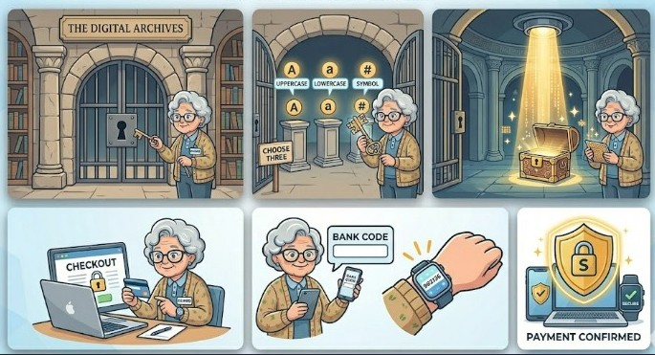
Week one Agenda
Introduction
Who are we
Navigating the Desktop
Using the Mouse
Managing files & folders
Updating operating systems
Adjusting privacy settings

Slide 3

Who we are
During the 2020 Census roughly 1 in 6 people in this country are 65 and older
A more recent census showed a 38.6% increase
The current population of Baby Boomers & Senior Citizens in this country is approximately 55.8 million and growing

Slide 4

What Impact do we have on our society
Unpaid Contributions: Older adults contribute hundreds of billions of dollars worth of unpaid activities such as volunteer positions and care giving
Active Workforce: Millions of Americans aged 65 and older remain employed or actively seek work, bringing stability and experience to the labor market
Political Equality: High participation rates among lower and middle income seniors help balance political representation across different economic classes
Wealth Control: Americans aged 70 and older control about a third of the nation's net worth & 40% of household stocks and mutual funds

Slide 5

Navigating the windows Desktop
Recycle Bin
PC Shortcut
Files & Folders
Windows Start Button
Task Bar
Status Tray [Notifications]

Slide 6
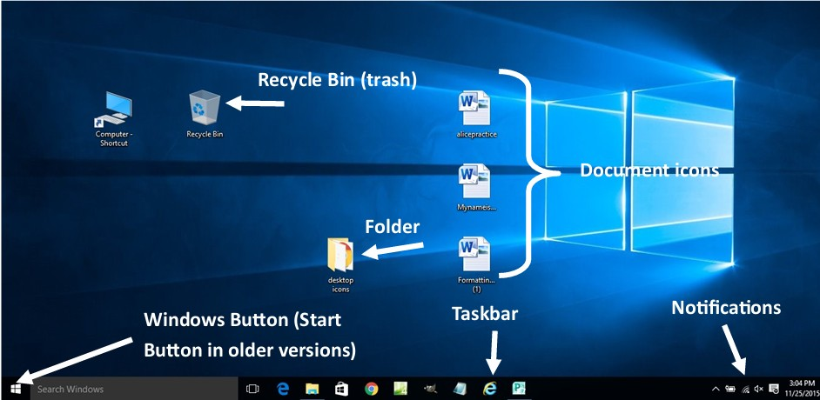
Windows Desktop

Slide 7
Using the mouse
Hold the Mouse with your whole hand not just your fingertips
Mouse Commands:
  LEFT CLICK: Click on the Left mouse button once to perform an action, like selecting an icon or following a web link
  CLICK TWICE: rapidly to open an icon on the desktop
  RIGHT CLICK: Click the Right mouse button once to bring up special menu of commands
  ONE CLICK: selects a program on the desktop, does not open a program
  DOUBLE CLICK: opens a program
  DRAG: Hold down the left mouse button while moving the mouse to drag a desktop icon or select an area on the screen or drag it across a line of text to high light or select the text for editing
  SCROLL: The Wheel on top of the Mouse is used to scroll thru pages in an application, document or web page

Slide 8

Creating files & folders
HANDS ON PRACTICE:
  Managing Files/Folders
  Updating Operating Systems
  Adjusting Privacy Settings

Slide 9
Week two Agenda
Introduction
Who are we
Navigating the Desktop
Using the Mouse
Managing files & folders
Updating operating systems
Adjusting privacy settings

